Slide 1



Whole Class Teaching
0
tip

Slide 2

Whole Class Teaching
1
tip

Slide 3

Whole Class Teaching
2
tip

Slide 4


Working Independently
0
tip

Slide 5
Working Independently
1
tip

Slide 6

Working Independently
2
tip

Slide 7
Working Independently
3
tip

Slide 8
Working Independently
4
tip

Slide 9
Working Independently
Use your time
to work on the assignments.

Slide 10
Whole Class Teaching
Please pay attention during explanation.
Please participate in exercises that
follow explanations.

Slide 11

Friendly
+
Fair

Slide 12
Example of 'Future Behaviour Letter’
Future Behaviour Letter
Name
Class
Answer the two questions below in well-written sentences. Before writing down the answers, make a draft. The teacher will keep the final version and can come back to it later. Return this letter to your teacher at the appointed time.
1 What is the reason for this letter, what happened? Please include at least three whole sentences, head, middle and tail.
2 What can you change/improve about your behaviour? Please include at least three whole sentences, head, middle and tail.
Signature Teacher Signature student

Slide 13
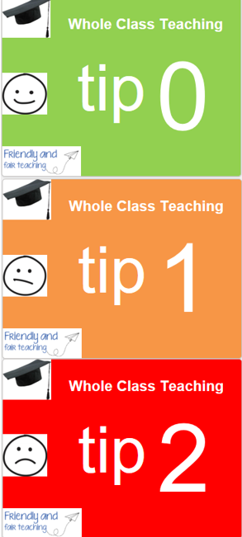
Whole Class Teaching

Slide 14

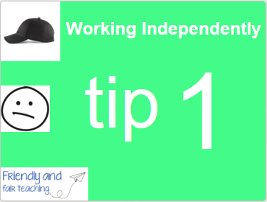
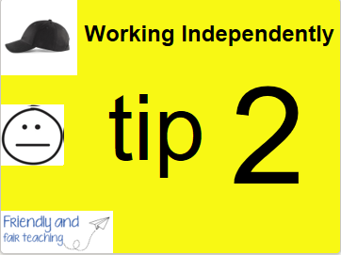


Working Independently

